Slide 1
Indigenous Research Methods: Why they matter
Lori Lambert, PhD
Caribou Crossing Research Station

Slide 2
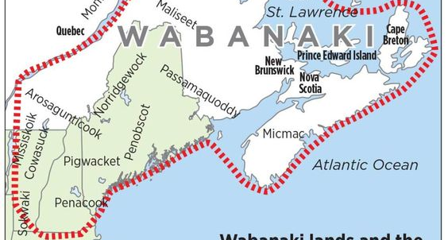
Location of the Tribes in the Wabanaki Confederation

Slide 3
Traditional Regalia

Slide 4
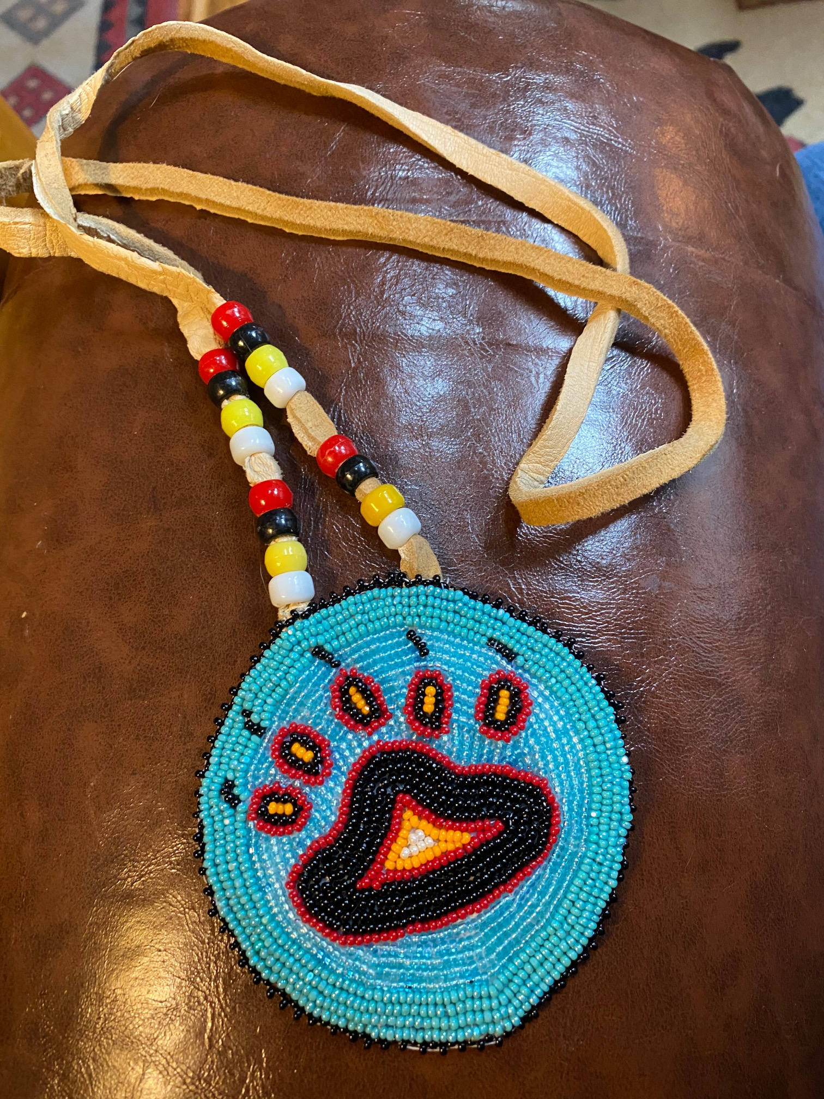
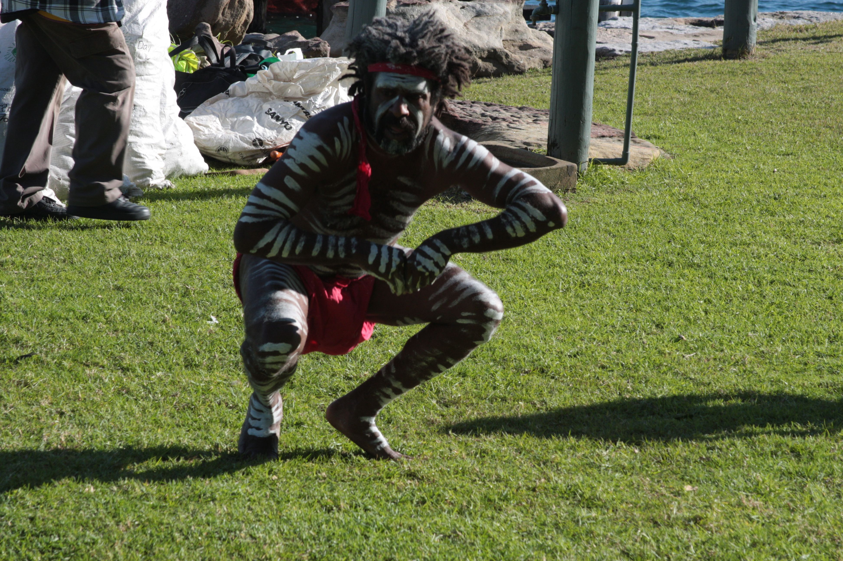
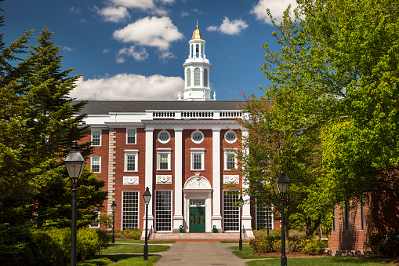
Who has the right to create knowledge and by what means?

Slide 5
History of Research Why it Matters
Western researchers conducted research in Indigenous communities:
* Without permission,
* Without consultation,
* Without involvement of Indigenous people,
* Without Respect.
* Indigenous peoples were objects of curiosity and subjects of research to be seen, but not asked, heard or respected.
Ethnic Plants of the Early Salish and Kootenai People Paperback – January 1, 1980

Slide 6
Quotes from the Elders.
“They are Just nosey.”
“They just want to find out stuff.”
“They got rich off us.”
“They never ask us what we need.”
“None of the data or solutions come back to us.”
“They take our stories, write the book or whatever their professors want and never give back to us.”
“They never tell us what they found and if they do, it is in language we don’t understand.”

Slide 7
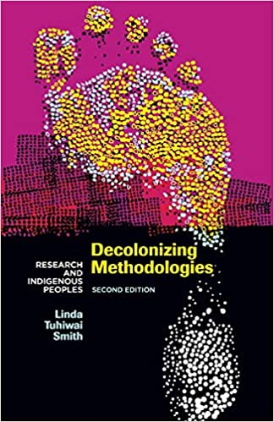
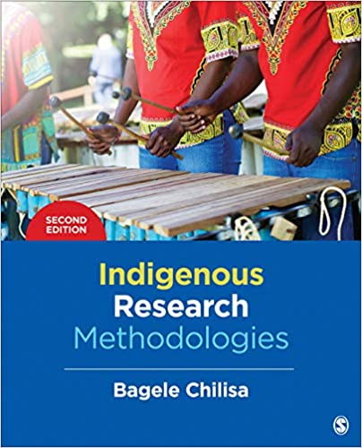
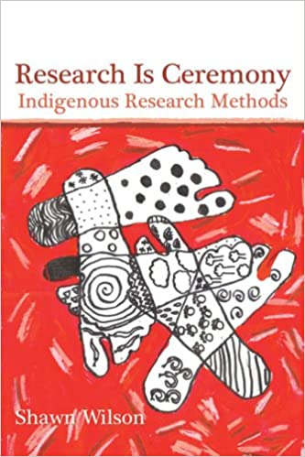
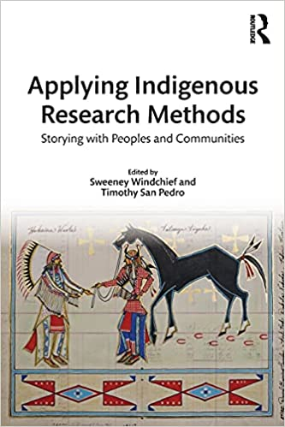
The Changing Image of Research
Dr. Linda T. Smith (New Zealand)
Dr. Oscar Kawagly (Alaska)
Dr. Shawn Wilson (Australia/ Canada)
Dr. Bagele Chilisa (Botswana, South Africa)
Dr. Maggie Kovach (Canada)
Dr. Vine Deloria (USA)
Dr. Beatrice Medicine (USA)
Dr. Joe Gone (Montana/USA)
Dr. Michael Yellow Bird (Canada)
Dr. Ku Kahakalau (Hawaii)
Dr. Sweeny Windchief

Slide 8
Who is the Indigenous Researcher?
*An Indigenous researcher conducting research in an Indigenous Community or with a population of Indigenous people.
An Indigenous researcher conducting research in a non-Indigenous community or with non-Indigenous people.
*A non-Indigenous researcher conducting research in an Indigenous community.
Windchief, S.& San Pedro, T. (2019). Applying Indigenous Research Methods. New York, NY: Rutledge
0

Slide 9
Native peoples have always been Researchers/Scientists
Discovered that beans, squash, and corn grow better when planted together.
Learned that smoked buckskin is water proof and un-smoked is not.
Learned by trial and error or by watching animals what plants treated certain ailments.
Discovered aspirin/willow reduced fevers; discovered the yew plant or rose hips prevented scurvy.

Slide 10
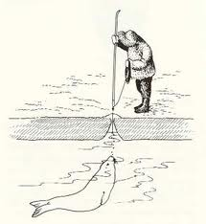
Learning from Animals

Slide 11
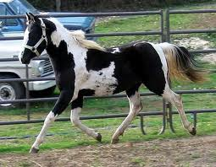
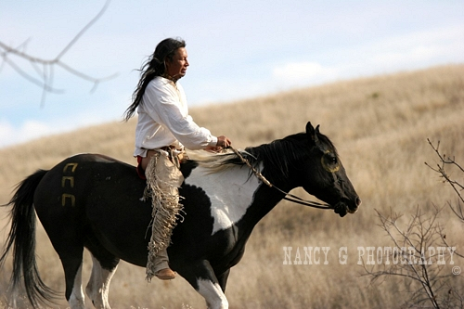
Research from our Paradigm Informs Western Science

Slide 12
Informing Western Science
Ogimakwe (Ojibwe) described the lesson learned from a group of trees. She talks how older trees give protection to the younger trees.
Researcher Dr. Suzanne Simard, UBC discovered though radiation testing of carbon, that the older Douglas Fir trees provide carbon to their saplings.

Slide 13
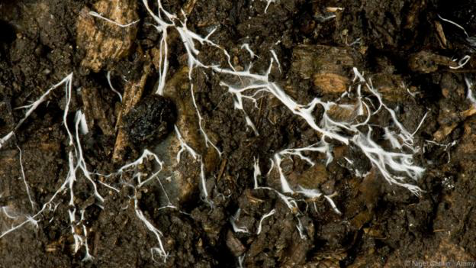
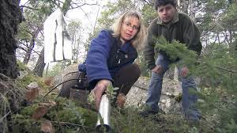
Dr. Susan Simard: Trees talking to each other
Measuring carbon from old growth trees to younger trees.
Transferred through the mycelium of fungi.

Slide 14
Indigenous Research in Engineering
Native use of flax fibers and bio-resins in place of petroleum-based matrices to generate more sustainable and environmentally friendly composite materials.
The composites may be used as roof shingles, sandwich panel skins, container walls and access door construction where weight reductions are required.
Blackfeet Tipis low and squat to the ground because of high winds in Browning.

Slide 15
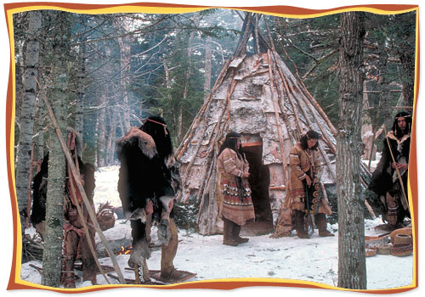
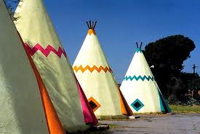
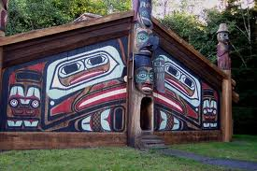
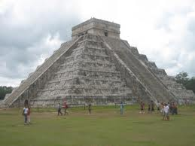
Indigenous Research in ENGINEERING: Place Based Research

Slide 16
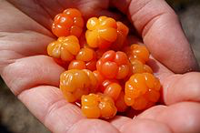
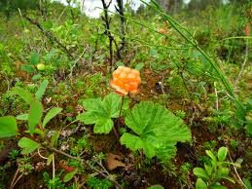
Indigenous Research in Pharmacology
The leaves of the Rubus (raspberry and cloudberry) , according to modern analysis, are also high in magnesium, which is still in use to prevent miscarriage."
Maybe the same useful chemical occurs in all the Rubus species; if so, the Crees were intuitively correct in using Cloudberry plants to help women’s problems.

Slide 17
Indigenous Research in Astrophysics
The Stars we Know: a Blending of Crow Astrophysics, Ethnography, and scientific observation.
History of the Constellations and sense of place in the universe.
SKC’s Bison Cube Satellite.
Developed cameras for the first Mars Rover.

Slide 18
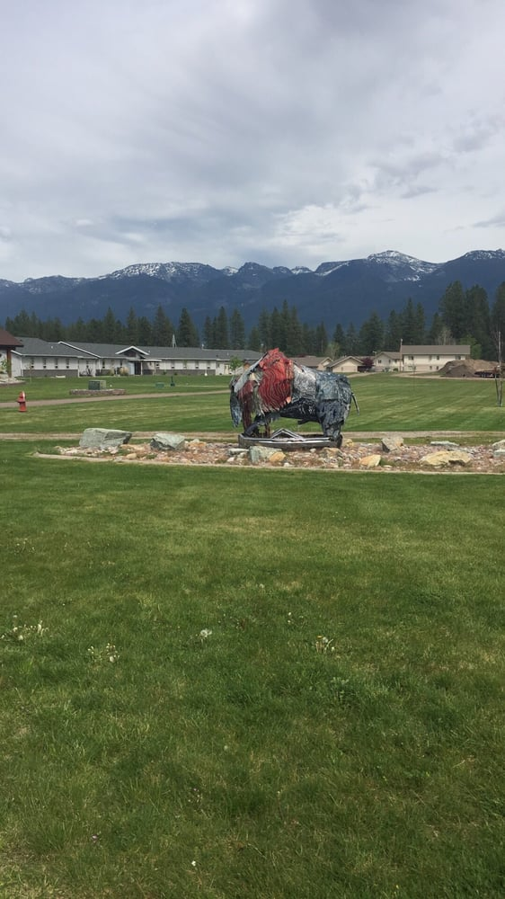
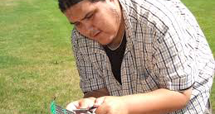
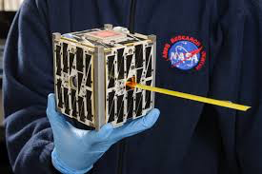
Salish Kootenai College’s Bison Cube Satellite

Slide 19
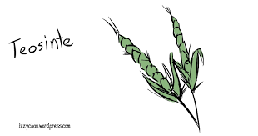
Indigenous Research in Farming
10,000 years ago no corn, just a small grass-like plant called teosinte.
Today corn feeds over 10 million people,
Three sisters farming: corn, beans squash
originated with the Haudenosaunee or "People of the Longhouse".
Potatoes, tomatoes, chocolate all the result of Indigenous research

Slide 20
Three Sisters Farming

Slide 21
Western and Indigenous Scientific Method
Step 1: OBSERVATION (for the purpose of gathering information)
Step 2: HYPOTHESIS FORMULATION (a general conclusion [generalization] based on that observed in Step 1) also called making a hunch about the observation.
Step 3: EXTRAPOLATION (from generalization to a specific application in a previously unknown area)
Step 4: OBSERVATION (for the purpose of corroborating the generalization). Does it happen again?
Notes:
Today more than ever the Western science is collaborating with Indigenous science to help solve challenges affecting the global arena.

Slide 22
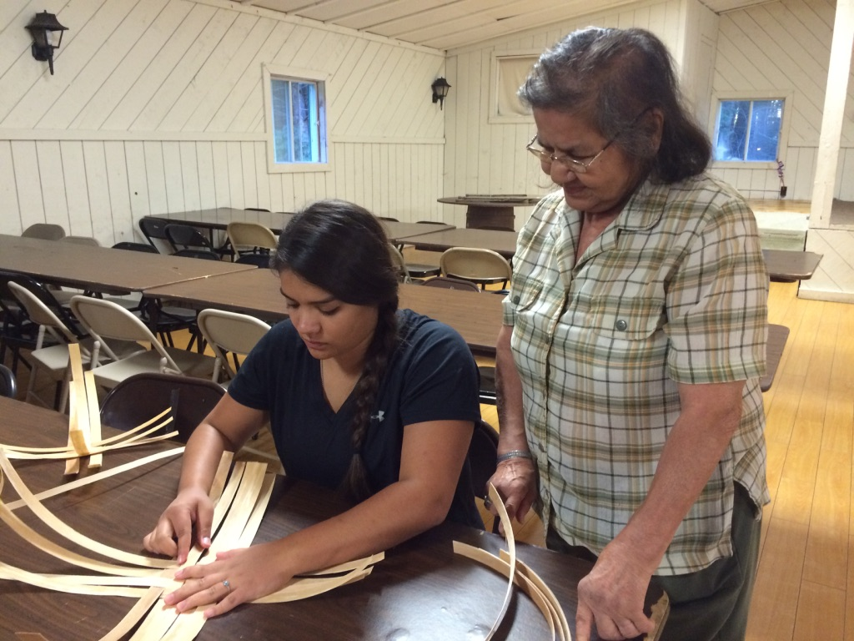
Looking forward Reaching Back
Solving problems for our future but remembering our paradigm, history and ancestral knowledge.

Slide 23
Indigenous Research
Targets a local phenomenon (Place Based) instead of using external theory from the West to identify and define a research issue.
* Can be integrative, that is, combining Western and Indigenous theories; Mixed Methods. Two-Eyed Seeing: Albert Marshall Mi’kmaq Elder.

Slide 24
Indigenous Research
It is context-sensitive and creates locally relevant methods, and theories derived from local experiences, and traditional Indigenous knowledges.
Assumptions about what counts as reality, knowledge, and values in research are informed by an Indigenous Paradigm.

Slide 25
An Indigenous Paradigm is a belief concerning:
Culture
Ceremonies
Land, environment, the natural world
Prayers
Artifacts
History
Clothing

Slide 26
An Indigenous research paradigm dictates:
How a specific culture views a subject,
World view accepted by a culture,
Includes concepts about a subject, a structure of what direction research should take and how it should be performed according to that world view.
What is studied and researched,
The type of question that is asked,
The exact structure and nature of the questions,
How the data of the research is analyzed and presented to community.

Slide 27
Indigenous Paradigm
* The Name is Misleading: Umbrella Term
* The Paradigm comes from the community who are our research partners or from the Indigenous researcher’s world view:
Yupik Paradigm
Salish Paradigm
Mi’kmaq Paradigm
Hawaiian Paradigm

Slide 28
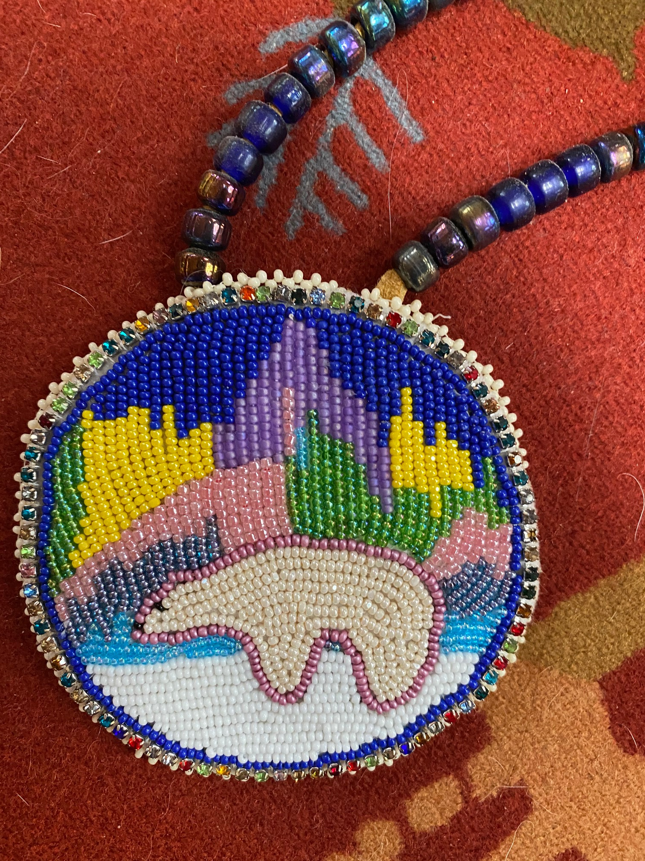
Methods vs Methodologies
Methodologies: The study of the methods appropriate for
data gathering in that community. Thinking and learning about the community.
* Methods: How the data is gathered and the decision to apply that method is unique to each community. i.e. face to face meetings, Talking circles, oral histories, art, seal hunt, potlach, etc. Never a mailed paper survey!!!
.

Slide 29
Questions for the researcher
Why do I want to do this research?
What is my role as a researcher?
How am I fulfilling that role?
Does this method allow me to fulfill my role in this relationship?
How am I changed by this research?
Notes:
Just to get tenure? Just to get a grant? Or to help the people.

Slide 30
Indigenous Knowledge
How Can Indigenous Knowledge Inform your Research Question?
* What Epistemological (Indigenous knowledge) have your participants or community written, created art, told stories, sang songs, have oral histories about your research problem.

Slide 31
Indigenous Methods of Research
Respect
Relationships
Relevance
Resilience
Reciprocity

Slide 32
Why Indigenous Methods Matter
* Lack of Respect for Indigenous people and who they are, not just as individuals, but, more fundamentally, as a people.
* Relationships: Building relationships in the community. Go to events, be seen, eat the food, participate in activities.

Slide 33
Why it matters, continued
* Ignorance of Relevance for alternate worldviews and a failure to acknowledge Indigenous peoples’ knowledge to participate in the research
* Reciprocity both in knowledge and in relationships, Giving information back to the community
* Resilience: How the question is asked.; strengths of the community.

Slide 34
Respect: Methods
Choice of:
Methodology
Research Topics
How the question is asked ~ questions of resiliency.
Forms of analysis
Presentation of the Data

Slide 35
Respect: Methods
* Comes from the heart/passion of the researcher and why you want to do that research.
* Researcher must live in the culture of the community/of the tribe.
* Tribe selects the problem and agenda. They partner with the researcher in what is researched. Present to Tribal Council and Tribal IRB.

Slide 36
How is my research demonstrating Respect
For the culture, Stories, language, the lifeway/paradigm,
For the natural resources and sacred places,
For the history of the people,
For the ethics of the community,
Am I in collaboration and cooperation of the tribal/Indigenous government?
Did I ask for permission?
Am I staying for tea?

Slide 37
Respect: Questions for the researcher
How does the research protect the natural resources?
How does the research contribute to and protect cultural values?
Who owns the data?
Is the data given back to the community in ways the people can understand?
How does the research empower the community?
How does the research contribute to self determination of the community?
How does the research promote recovery from from historical anger, loss of self esteem, loss of tribal identity?

Slide 38
Relationships: Methods
Comes from the heart/passion of the researcher and why you want to do that research.
Researcher must understand the culture of the community/of the tribe.
Tribe selects the problem and agenda. They partner with the researcher in what and how research is carried out.
Return to the community with the data in ways the people can understand.

Slide 39
Resilience: Your Research Question
Strength-based Inquiry
Instead of asking, “What are the elements in the lives of 7th grade children who smoke pot?”
Ask the question: “What are the resilience behaviors for 7th graders who don’t smoke pot?”
Environmental Inquiry:
Instead of asking “Why are the bees dying in this ecosystem?”
“What are the elements in this ecosystem that allow bees to flourish?”

Slide 40
Respect: Methods
* Research Topics: Collaboration with the community,
* How the question is asked ~ questions of resiliency,
* Data Collection Methods~ study of the methods,
* Forms of analysis,
* Presentation of the Data,
* Data Sovereignty.

Slide 41
The Conceptual Framework
1. Makes visible the way we see the world,
2. Reflects the researcher’s perception of reality,
3. Demonstrates how the research empowers the community,
4. Can demonstrate how the research helps the community heal from Historical Trauma.
5. Demonstrates that the researcher understands the community’s culture.
6. Demonstrates responsible ethics..

Slide 42
Research can be Confusing…like going hunting, you need a path/map to follow: hunting for knowledge and truth.

Slide 44
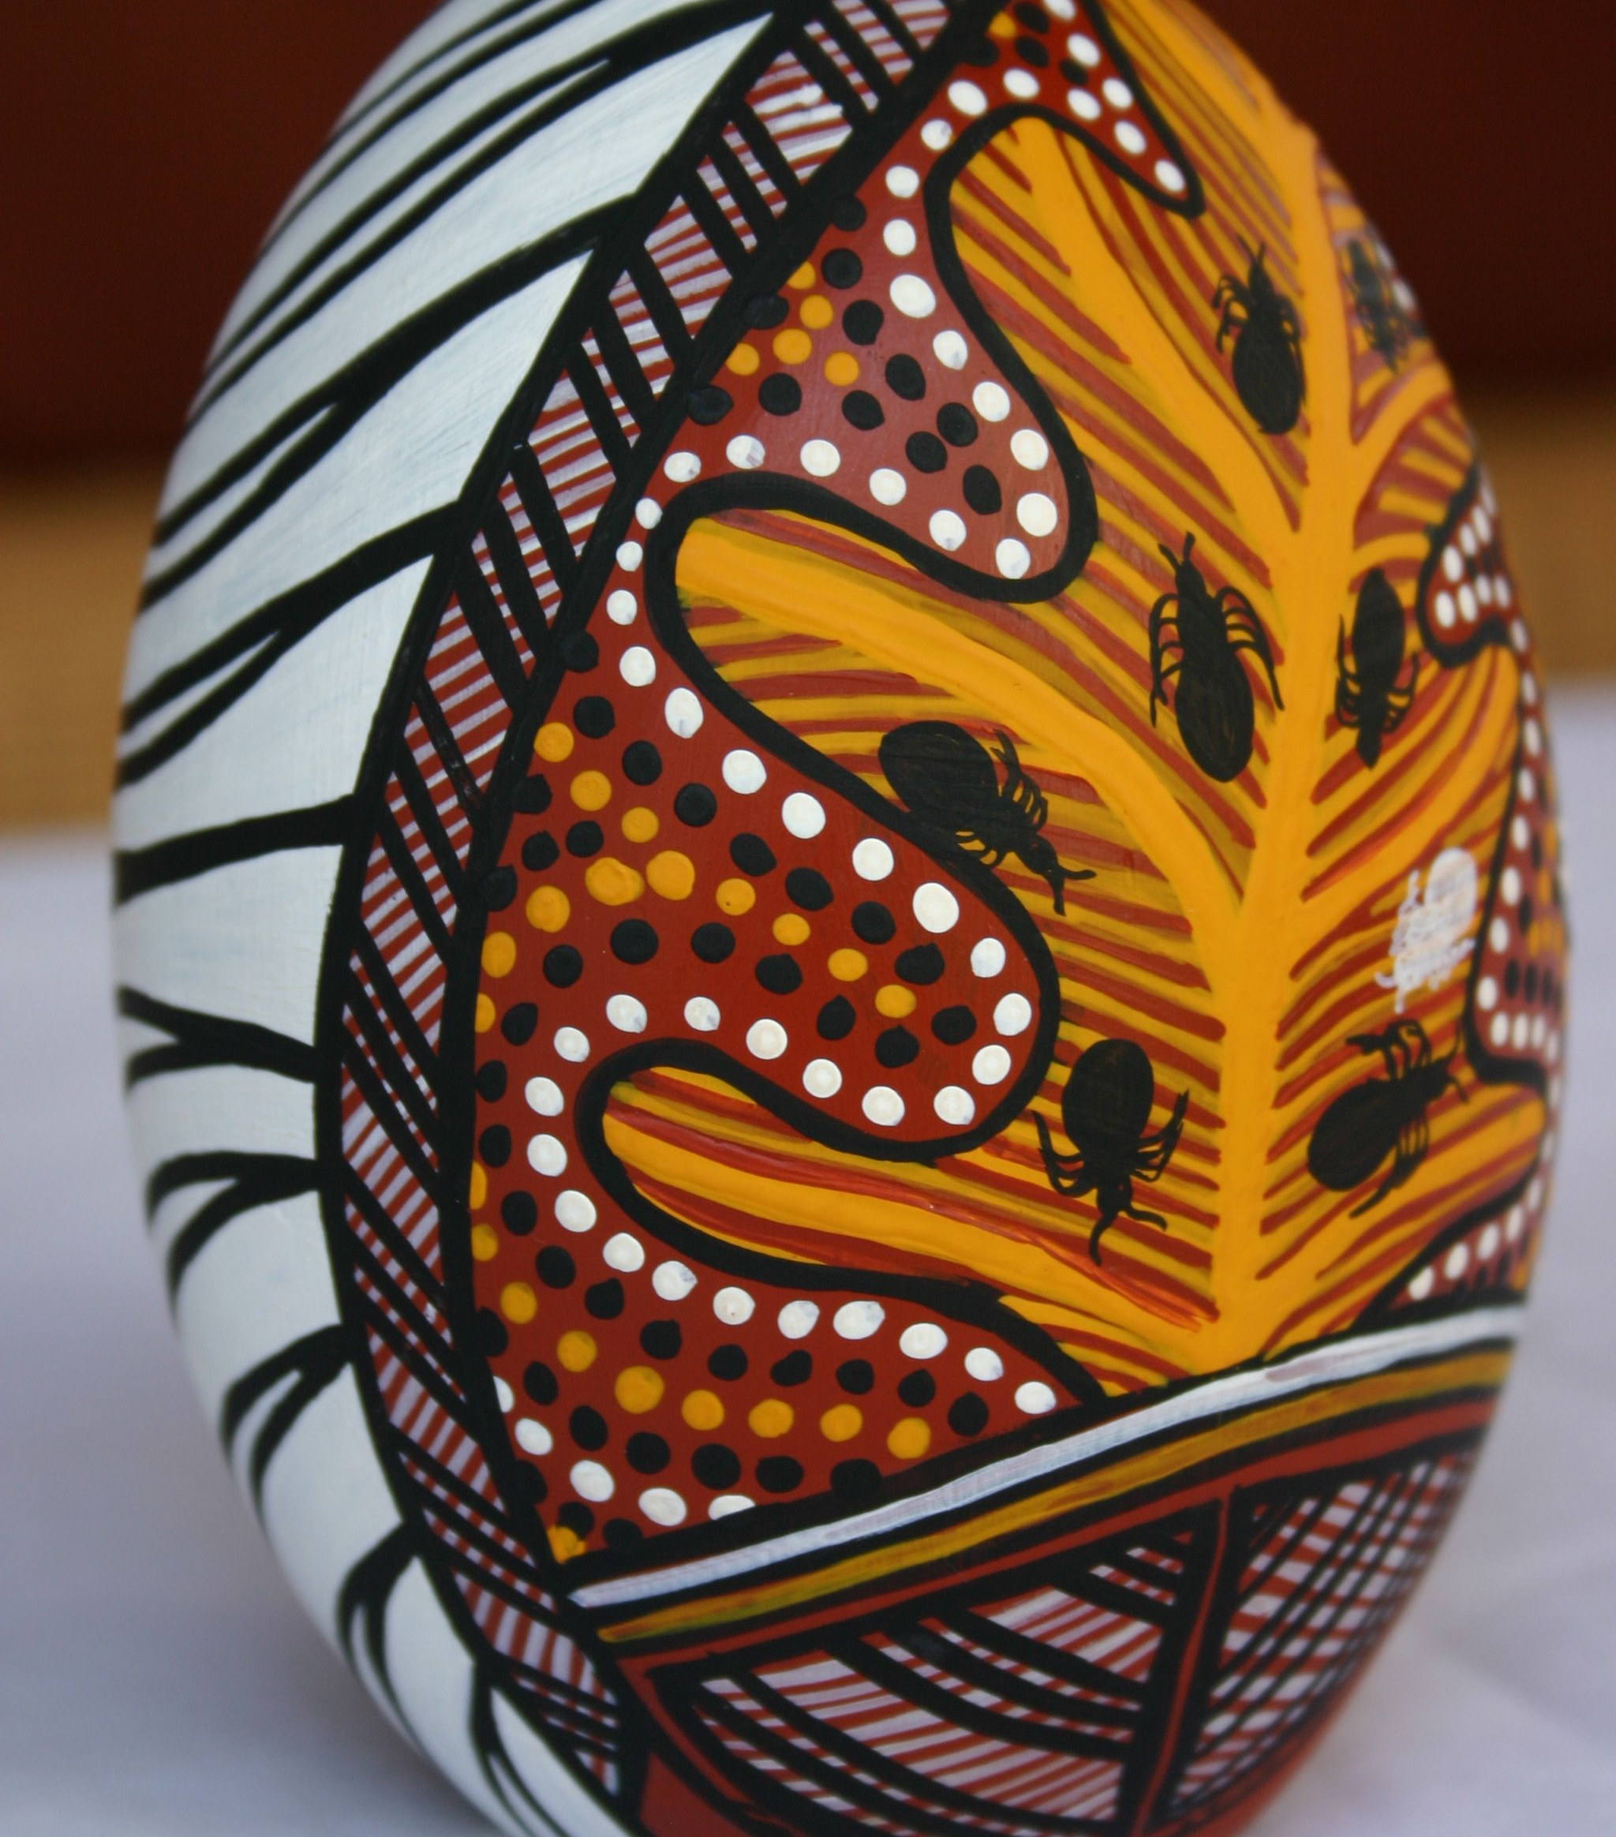
What can be gathered as Data?

Slide 45
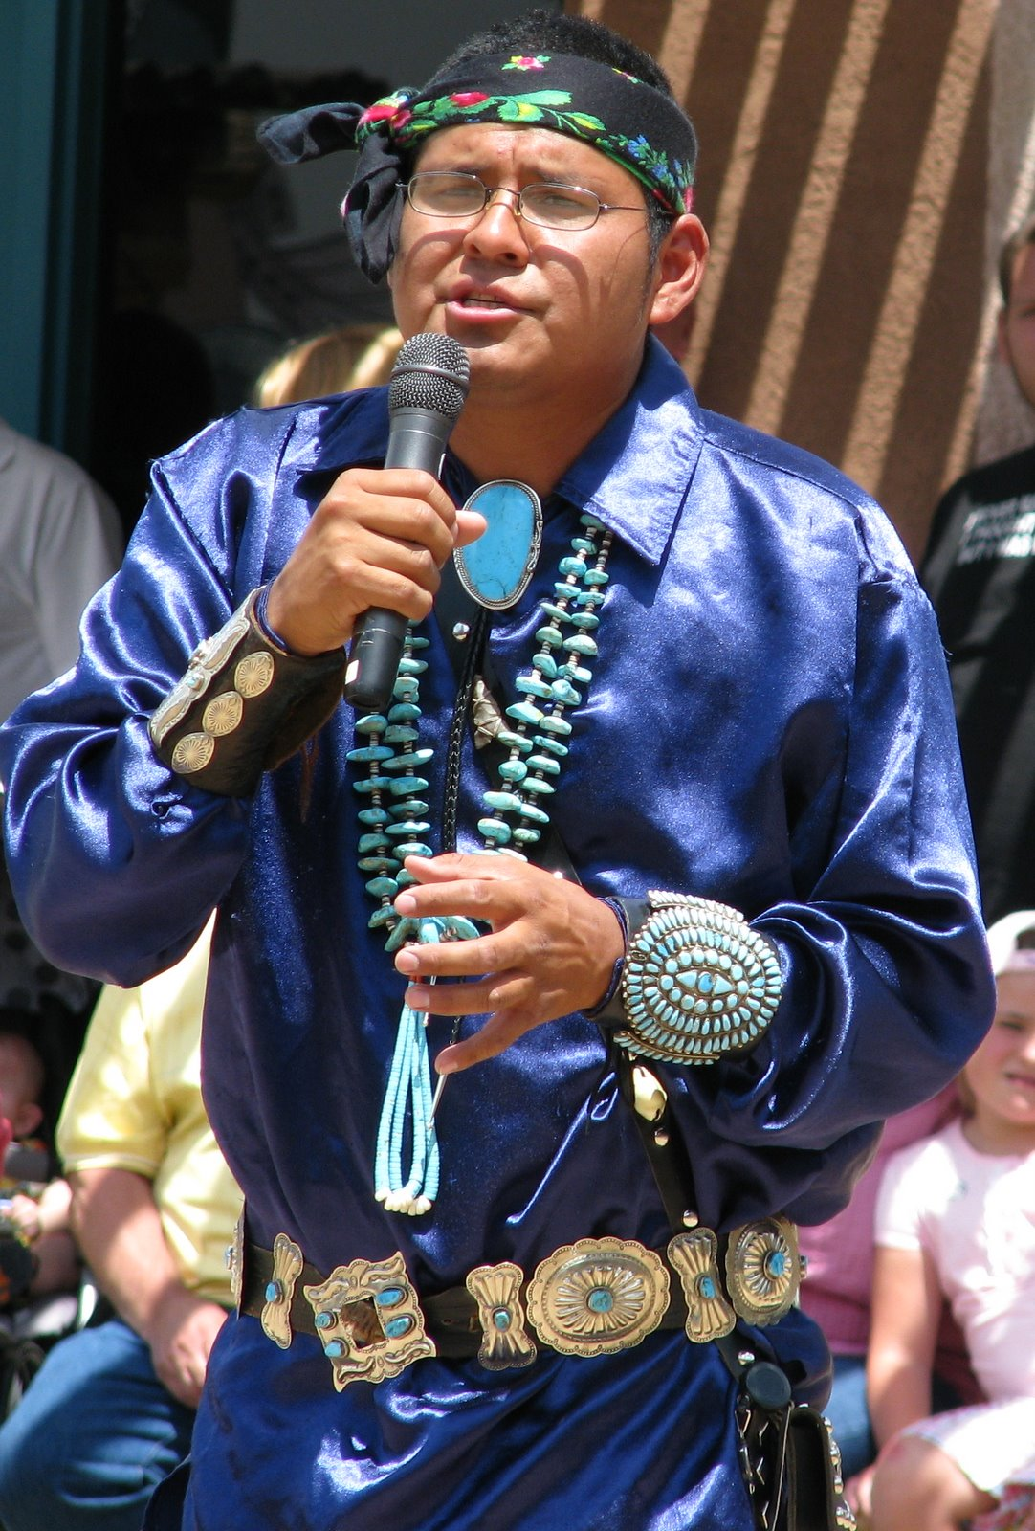
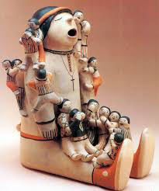
Stories, Songs, Oral Histories, Dreams, Ceremonies

Slide 46
What is the method of collecting data?
* Stories told in Sharing Circles,
* Interviews with leaders,
* elders’ visits,
* oral histories,
* field observations,
* abiotic and biotic data;
* Potlatches, seal hunts,
One on one visits not just one visit~ grab and go…stay for tea…create relationships: with the land, the food, people.

Slide 47
Story
Unique ways that Indigenous/Aboriginal Peoples use in teaching and learning.
It is within the story that there is a place for honoring of oneself, family, community, place, the environment and spirituality.
Each concept and event is set in place that is based on history, place, environment and process which intertwine within one larger story of tribe, community, land, and nation.
(Dr. Pamela Croft, 1997)~ Aboriginal Researcher, Queensland Australia)

Slide 48
Stories as Data
* Stories are the tools of data collection, analysis, and interpretation,
* Stories allow the participant to tell their experiences from their perspectives.
* Stories provide data on a variety of issues. (Chilisa, 2012)

Slide 49
Stories, continued
* Many kinds of stories: Creation stories, historical stories, stories of current events, personal stories.
* Relationship with the story teller,
* Relationship with the story,
* Interpretation of the story~ Is this what the story teller means?
* May not be the same for every listener,
Is the story teller credible?

Slide 50
Cultural Ceremonies as Data: Cultural Permissions
Sun Dance
Sweat Lodge
Smudges
Dances: Jump dance, Powwow Dance, War Dance, Coffee Dance
Among the Republic of Congo (ROC), and other nations have dances for everything from rain, feel good, to prevent depression.
Notes:
Not that these ceremonies are exploited or described in the proposal, but which tribes engage in these ceremonies…

Slide 51
Dreams and Songs as Data
Dream of the Jingle Dress Dance,
Dreams that Predict future events,
The coming of the spotted buffalo and the white people.
(Black Elk)
Collecting Tribal Songs that have been lost to history
Helps the elders self esteem and leads to tribal self determination.
Hunch: Collecting and signing the old drum songs will bring our language back. (leads to the research question)
Notes:
Gathering dreams as historical; or in the case of the jungle dress for healing.

Slide 52
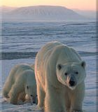
Environmental and wildlife data
Ecological Data
Climate change data,
Elders stories: before and after, new animals in arctic biomes…no Inuktitut words,
Changes in animal behavior, changes in the landscape told by Elders.

Slide 53
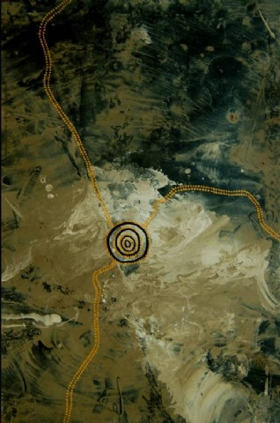
Indigenous Art as Research Data

Slide 54
Review of the Literature
How can Indigenous Knowledge inform your Research Problem?
What Epistemological (Indigenous knowledge) have your participants or community written, created art, told stories, sang songs, have oral histories about your research problem?

Slide 55
The Research Proposal
Introduce the problem statement. In a paragraph, describe the problem the community wants to solve.
Then a statement of your guess/hunch. What do you think will be a solution to this problem?
Now turn the hunch into a question..."will blah blah blah solve the problem"
State the question in a positive way. Resilience question.
Now Begin to write your research proposal. Begin with your story and why you want to do this research. Discuss tribal specific elements of your own “Place.” Under the Tribal specific element, write a paragraph on your own story. Put your voice into the proposal.
Who are you? Where do you come from? What is this Place you are from and researching from? Why do you want to do this research? What Paradigm or world view are you researching from? What does this project mean for your tribe or community?
How will your project include the elements of Indigenous research?

Slide 56
How will it move the community forward?
Write about how you think about Indigenous Methodologies and which method is best for this project.
What is the method you will use to gather data? Why did you choose this method?
3. Apply the elements of the conceptual framework and DISCUSS HOW YOU WILL IMPLEMENT THEM INTO YOUR PROPOSAL?
How will you protect human subjects? IRB (tribal/University)
Discuss how you go about approaching the community if you need an Advisory Board to guide your research. Who are the members of the Board? Why do you choose them?
Besides the formal paper, discuss how will you disseminate the information to the community?
A literature review is nothing more than the writings of other people on the topic you are researching and a description of their project. Ideas may include: What have other communities done about this problem? Use Oral Histories.
Description of the methods you use to collect the data.
Think about the ethics and the desires of the community when you are analyzing, disseminating, and presenting your findings to the community.

Slide 57
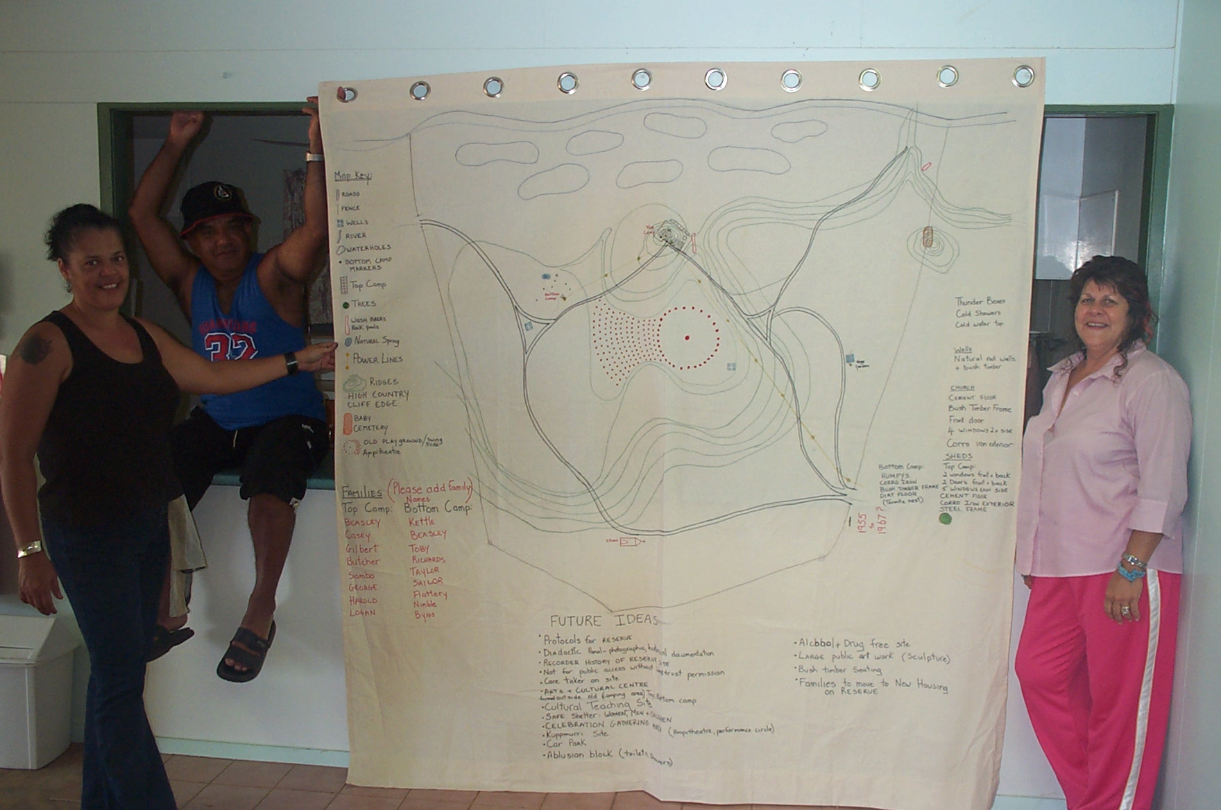
Indigenous Methods of Data Analysis and Dissemination

Slide 58
Data Sovereignty
Not the researcher (Just borrowing)
Not the professor
Not the university
Not the government
The research done in Aboriginal lands and the resulting data belong to the community. Data sovereignty
Data can be expressed in both qualitative and quantitative.

Slide 59
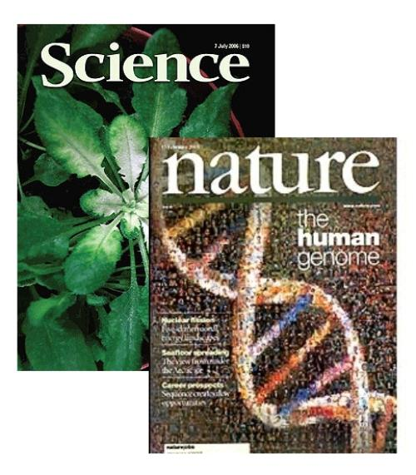
The IRB
Tribes and tribal college IRBs: Protection of the people, the culture, the land.
Your home university: Protection of the people.
Publishing: Permission from the culture Tribal Counsel; Tribal IRB
Authorship?

Slide 60
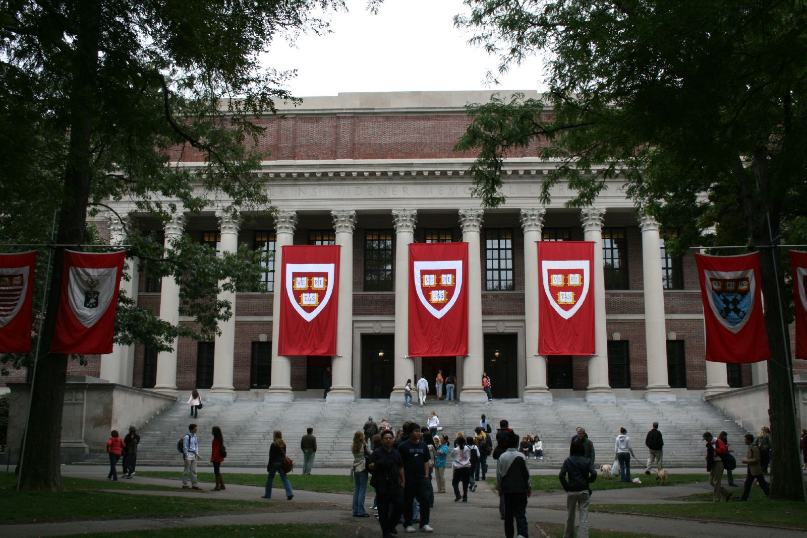
Indigenous Research Within the Academy
Notes:
The final step for Indigenous Researchers and Indigenous Research Methodologies is acceptance by their Mainstream Academic Institutions, by the faculty and Academia. This used to be a problem across North America Canada, the US, but today more and more institutions accept the research as a new paradigm. It is new but old.

Slide 61
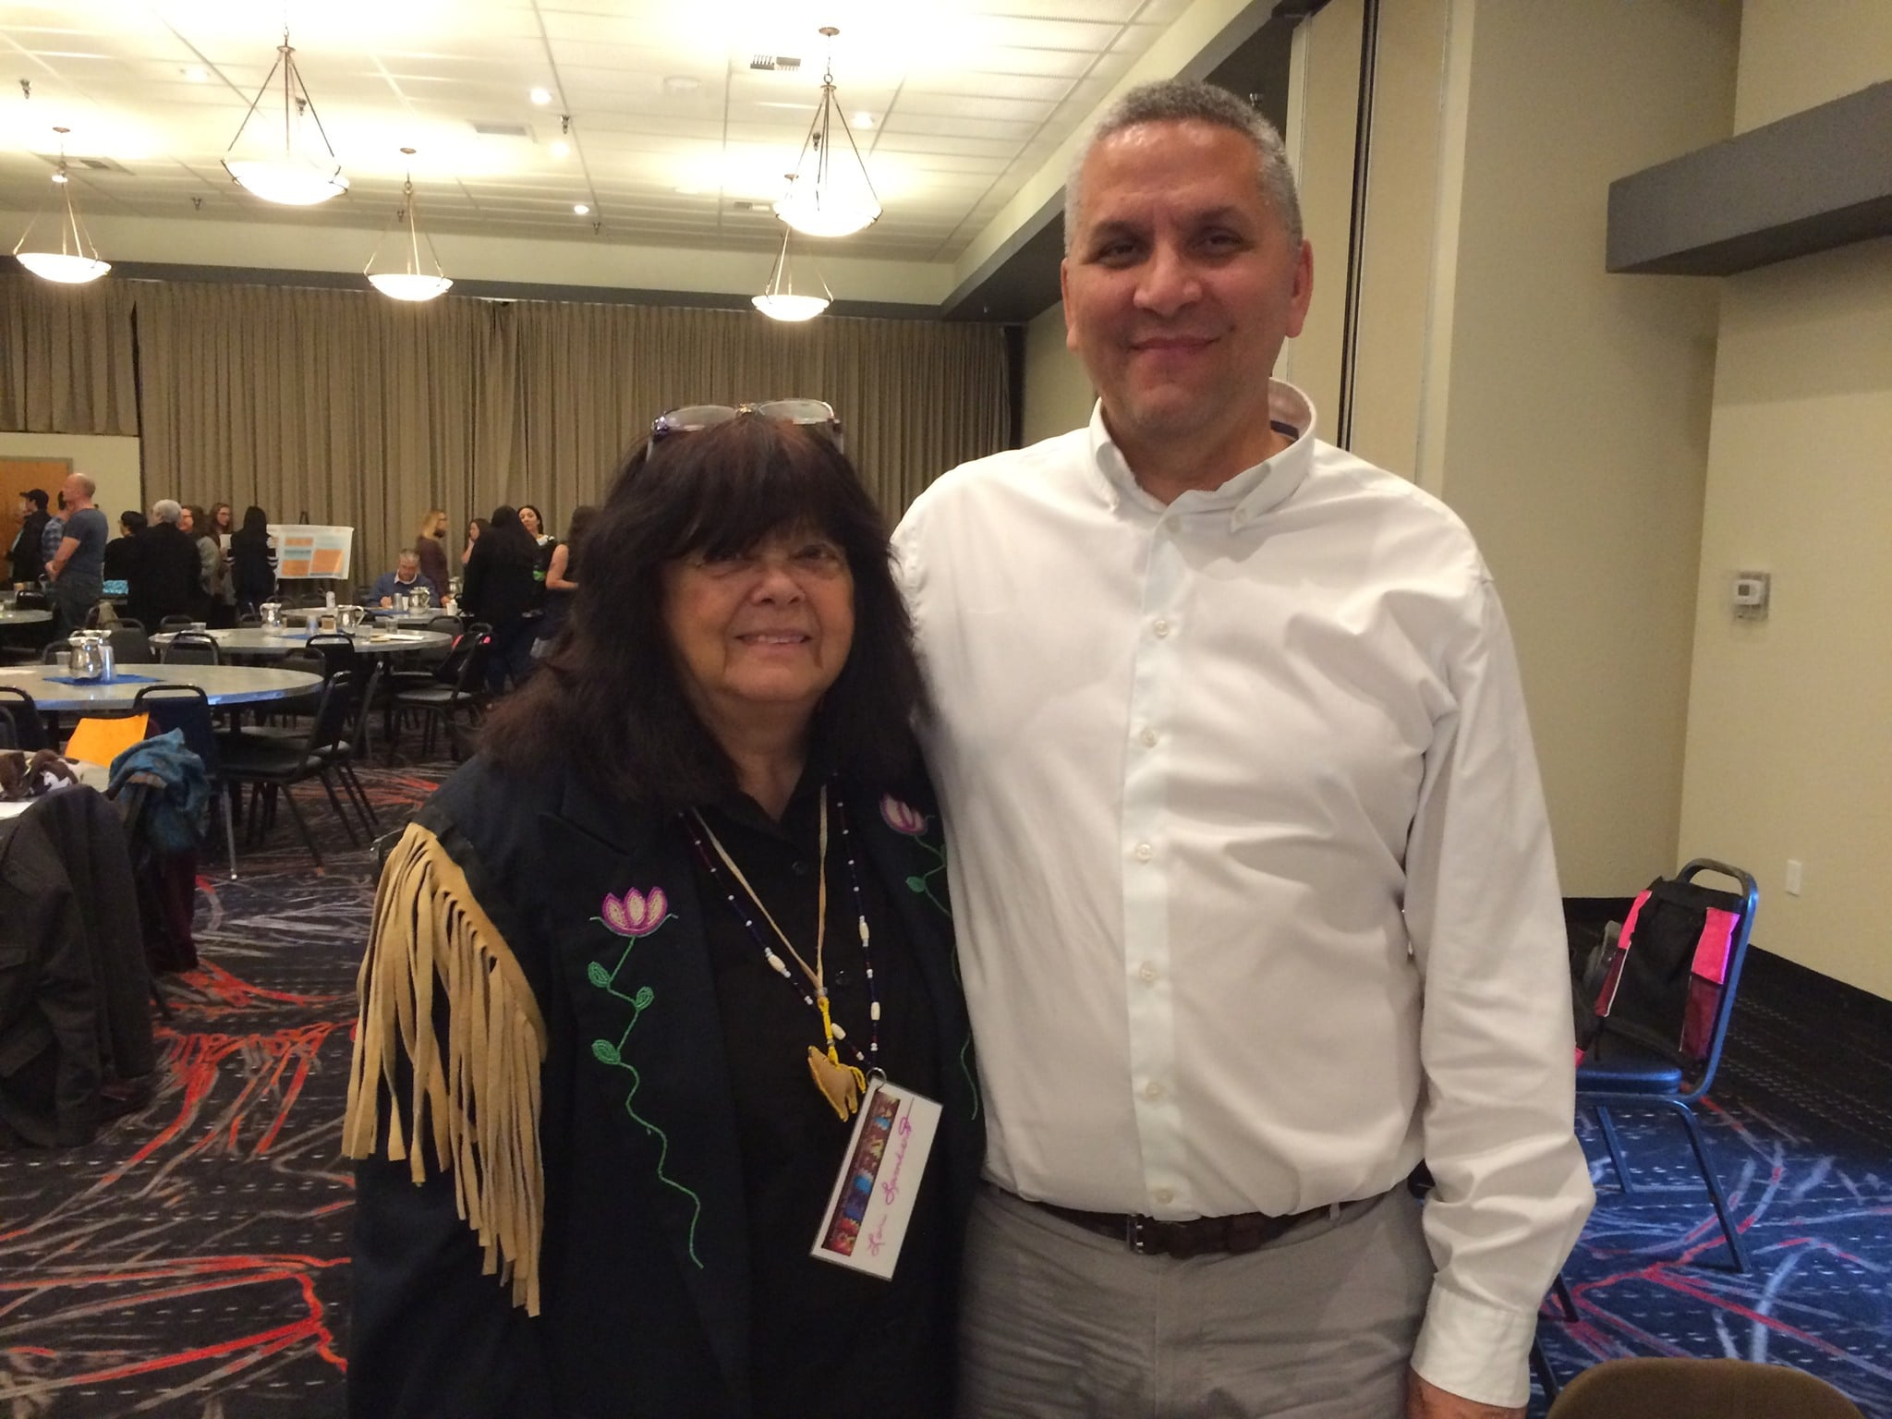
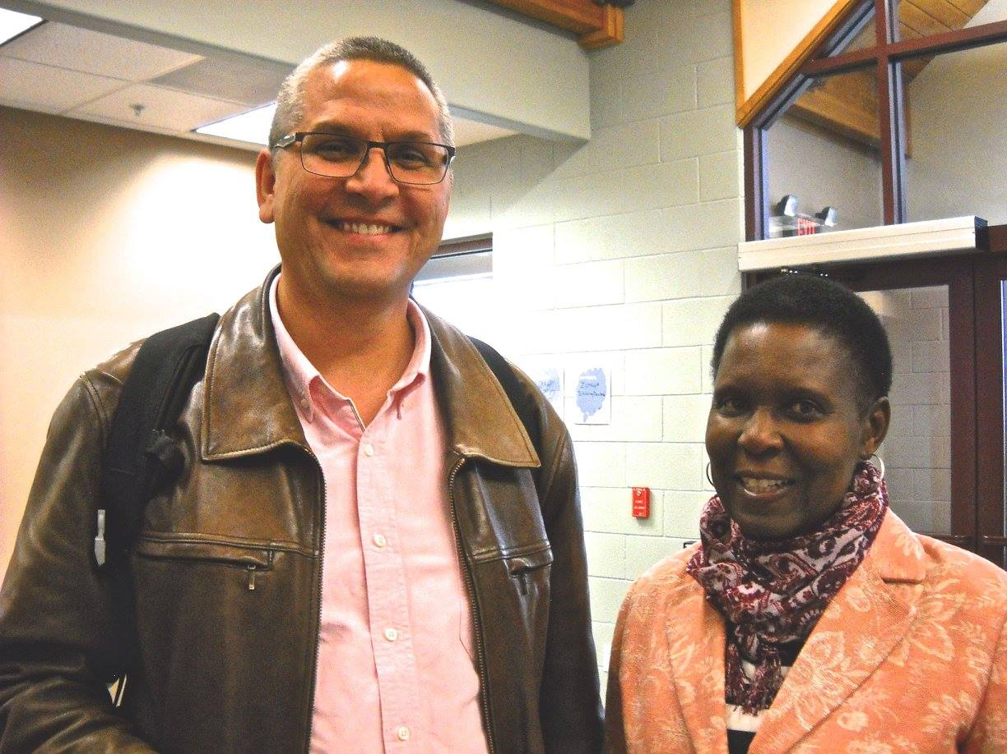
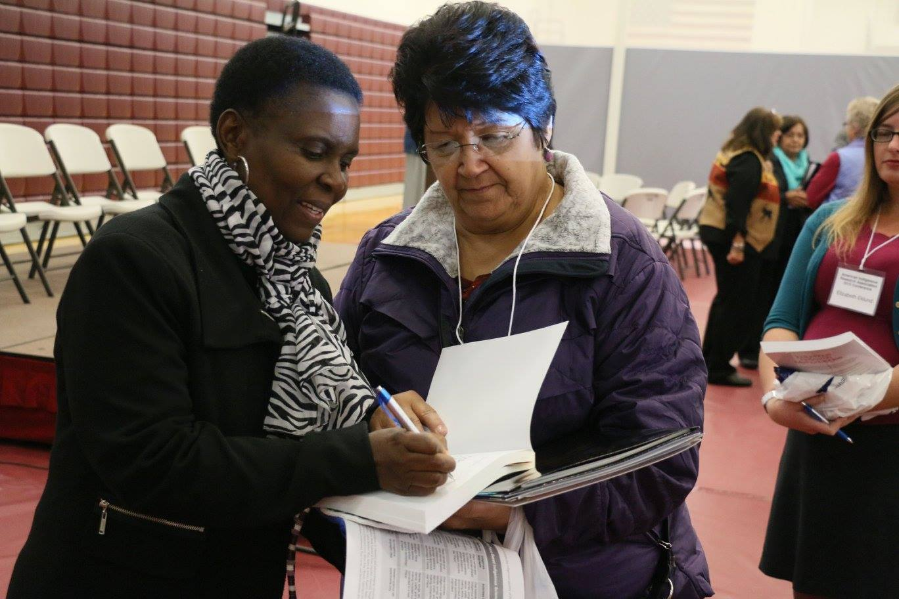
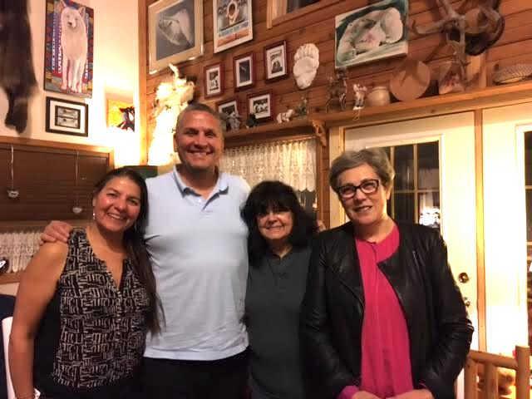
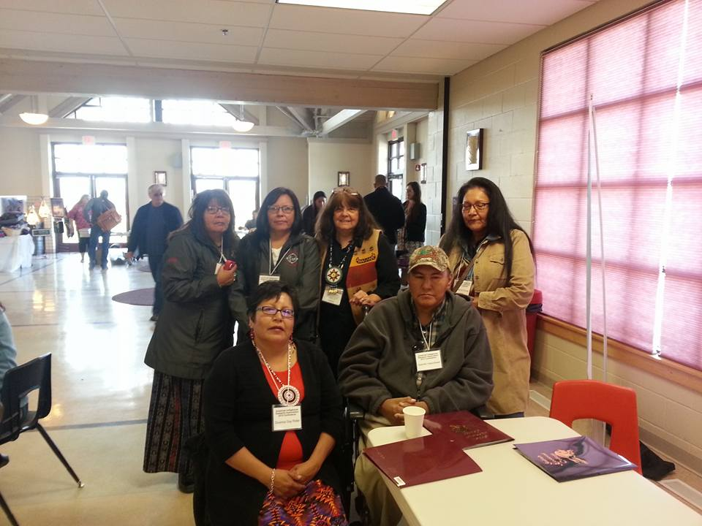
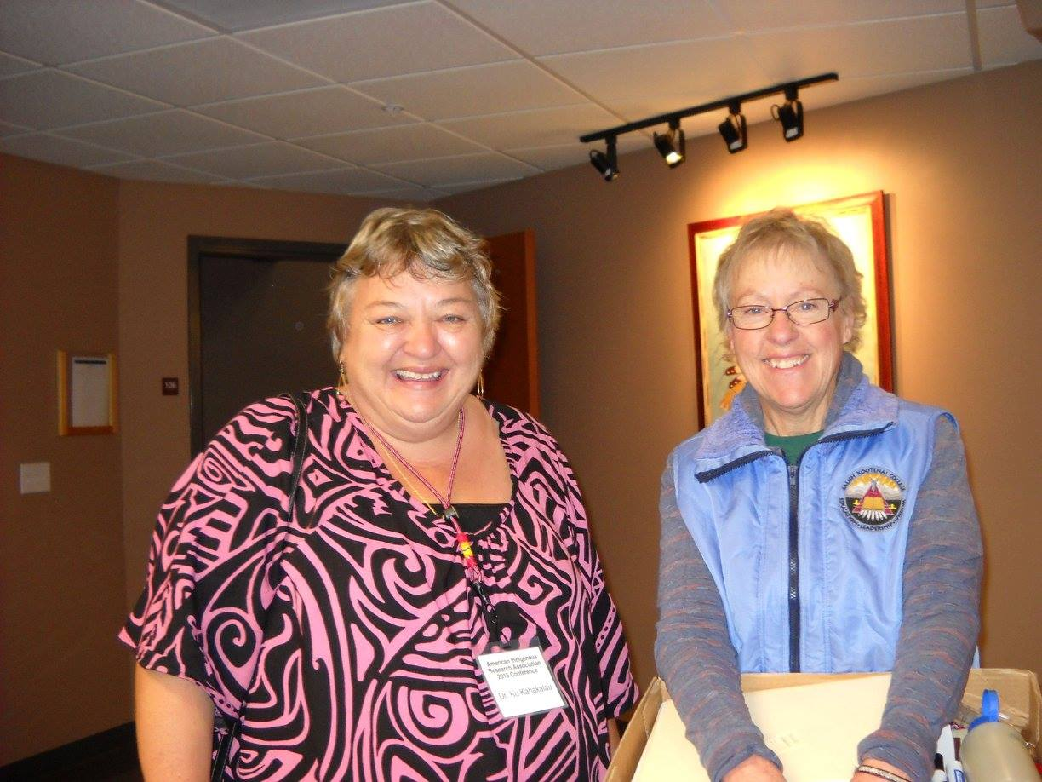
American Indigenous Research Association
Https://www.americanindigenousresearchassociation.org/

Slide 62
INDIGENOUS Methods
Community Based Participatory Research
1. Passion for the research/ Reflection of the researcher/paradigm of the researcher,
2. The culture of the community & community empowerment,
3. The ethics (Axiology), Ontology and Epistemology of the community,
4. Community interest and need,
5. Ownership of the data,
6. Methods of data collection and analysis,
7.Tribal protocols and methods of dissemination.
Community as the primary unit of identity.
Enhances and builds on the existing strengths of the community.
Fosters collaborative relationships between the academic institution and community partners throughout the entire research process.
Knowledge gained through the partnership is translated into specific action.
Notes:
Don’t go out with a particular research project in mind; go out around problems and look for solutions. You have to enjoy working together, and have good communication.” But it also requires understanding the issue at a community level.
ere should be money in it for the community. We need to incorporate them into grants. Co authors of papers. Western methods versus the paradigm methods of the researcher. Indigenous Research is more about the relationship of the researcher with the community rather than the relationship of the institution and the community.

